Slide 1
Cab Service

Slide 2
This project present in git repository in below URL
https://github.com/Kaleakash/mern_stack_running_capstone_project.git
Plz login to virtual lab and clone this project in virtual lab using command as
https://github.com/Kaleakash/mern_stack_running_capstone_project.git

Slide 3
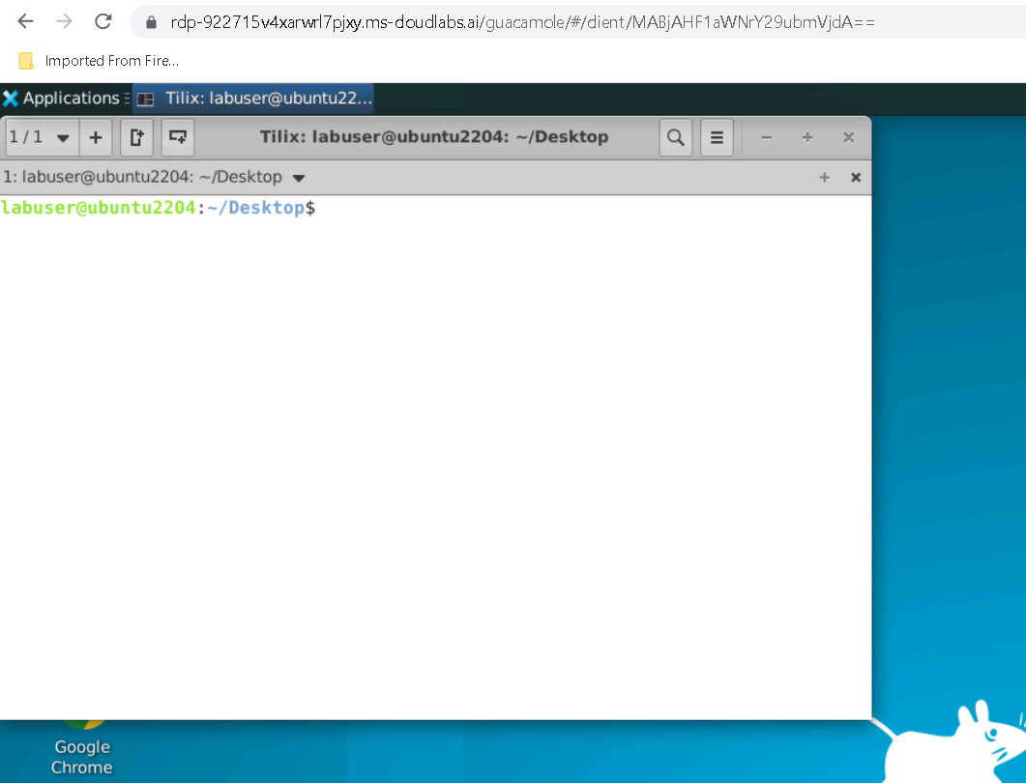

Slide 4
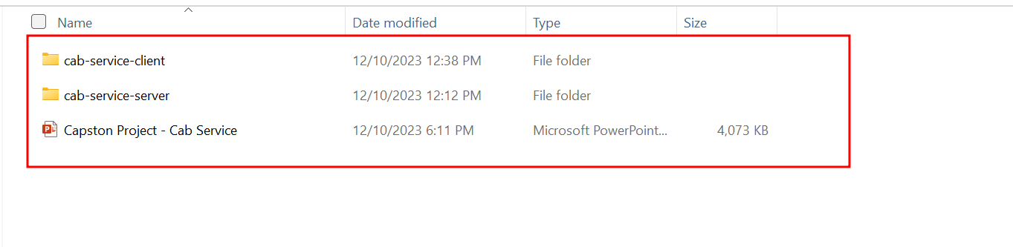

Slide 5
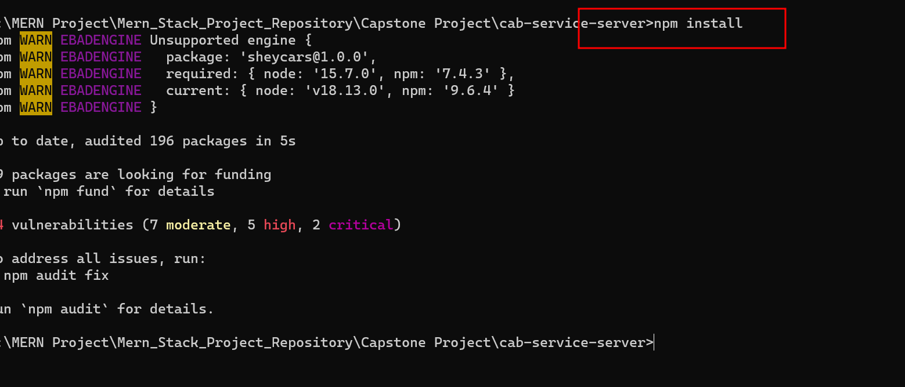

Slide 6
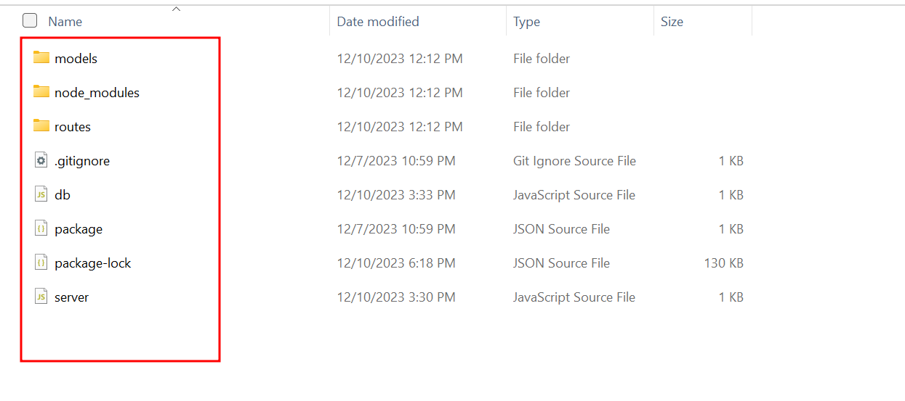
Project structure

Slide 7
Project structure explanation
In db.js file we can see the database connection details. If we use local machine database then ip address must be local host or 127.0.0.1 with port number 27017. database name is infer_car_db.

Slide 8
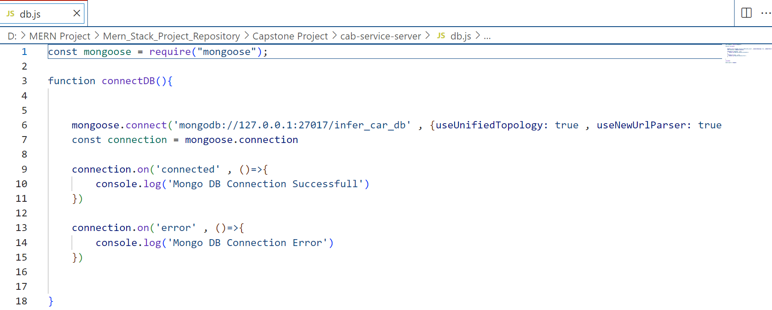

Slide 9
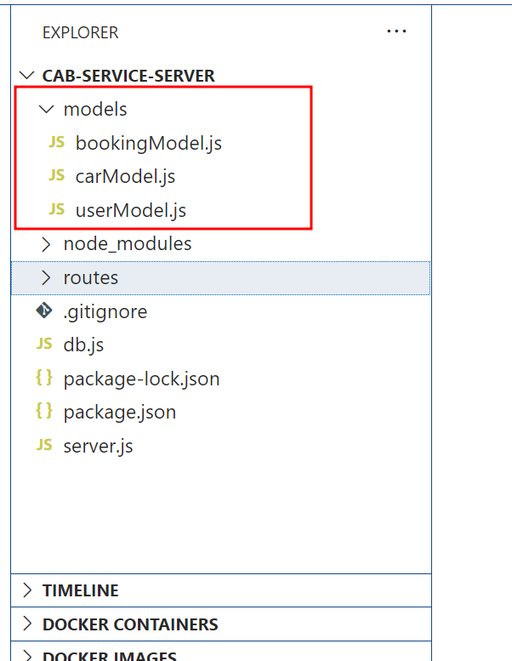
Model file: this file contains the structure of collection with schema definition

Slide 10
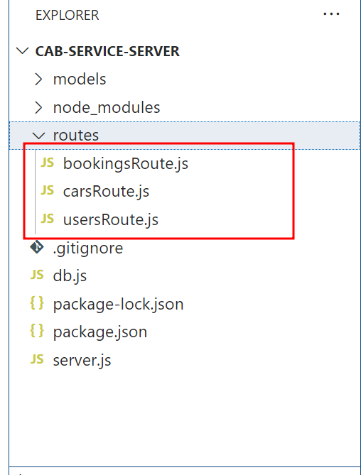
routes file: this file contains the structure of collection with schema definition.

Slide 11
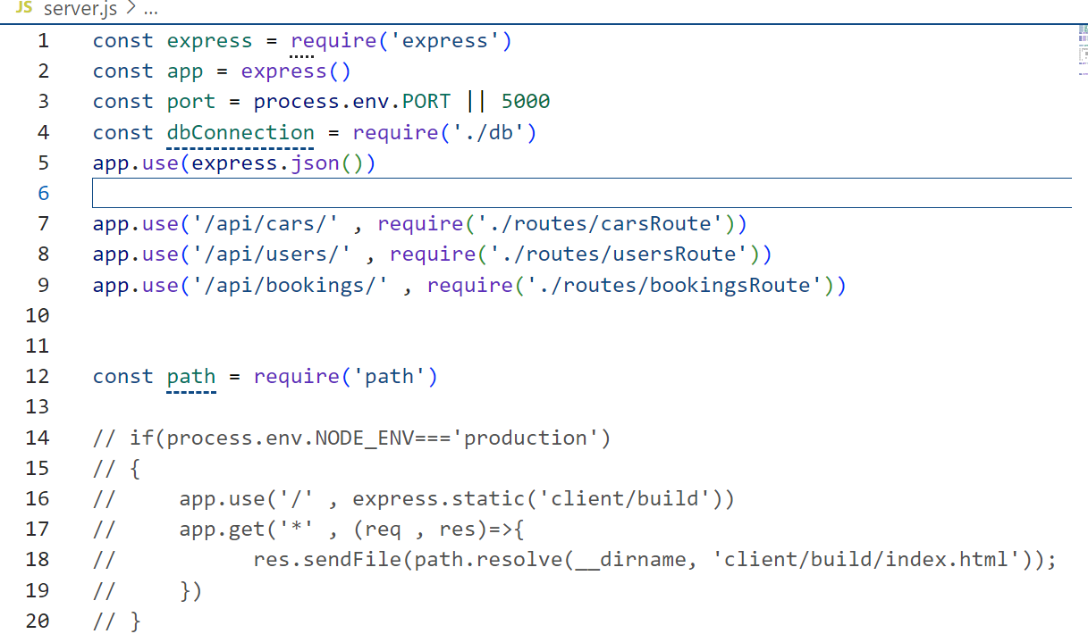
server.js file: this file contains the entry of the program with port number.

Slide 12
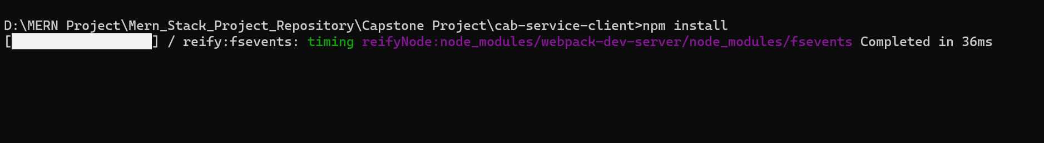
Now move inside a frontend folder
Then run the command as npm install --force to install all required dependencies.

Slide 13
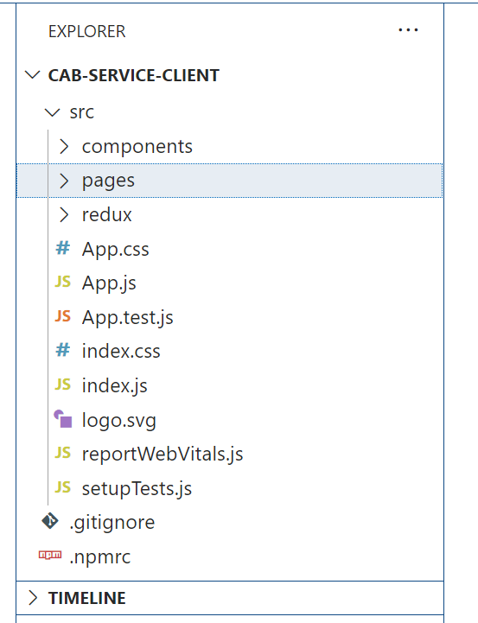
Front – react js project

Slide 14
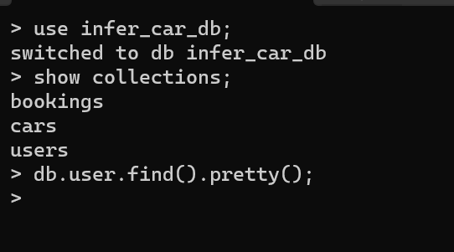
Database is mongo db
open the mongo db terminal

Slide 15
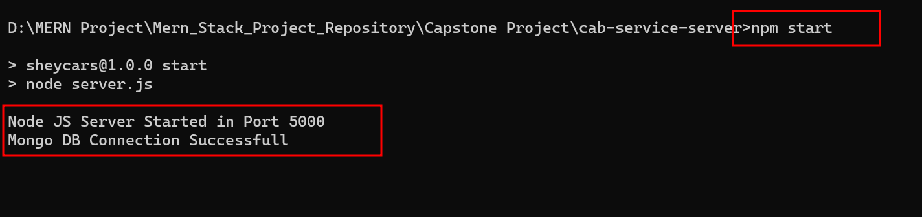
Now run the backend technology
Using the command as
npm start

Slide 16
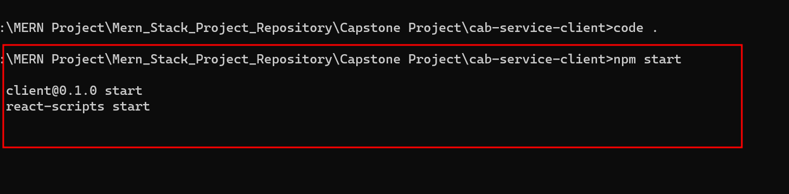
Now run the frontend technology
npm start

Slide 17
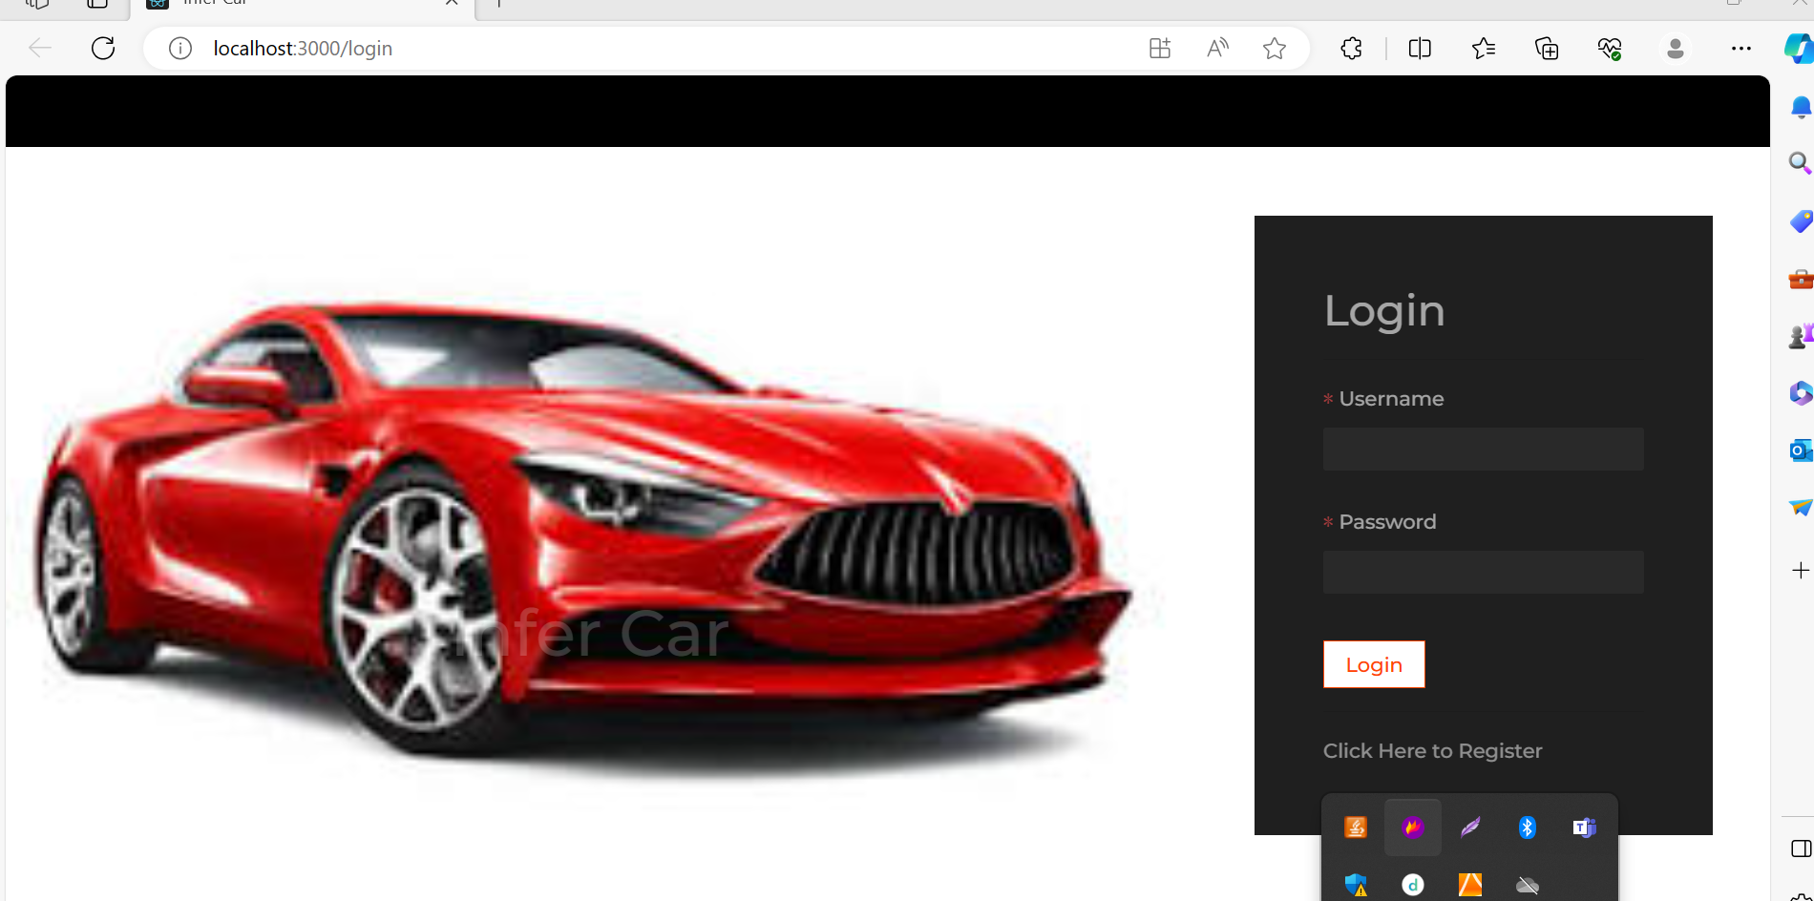

Slide 18
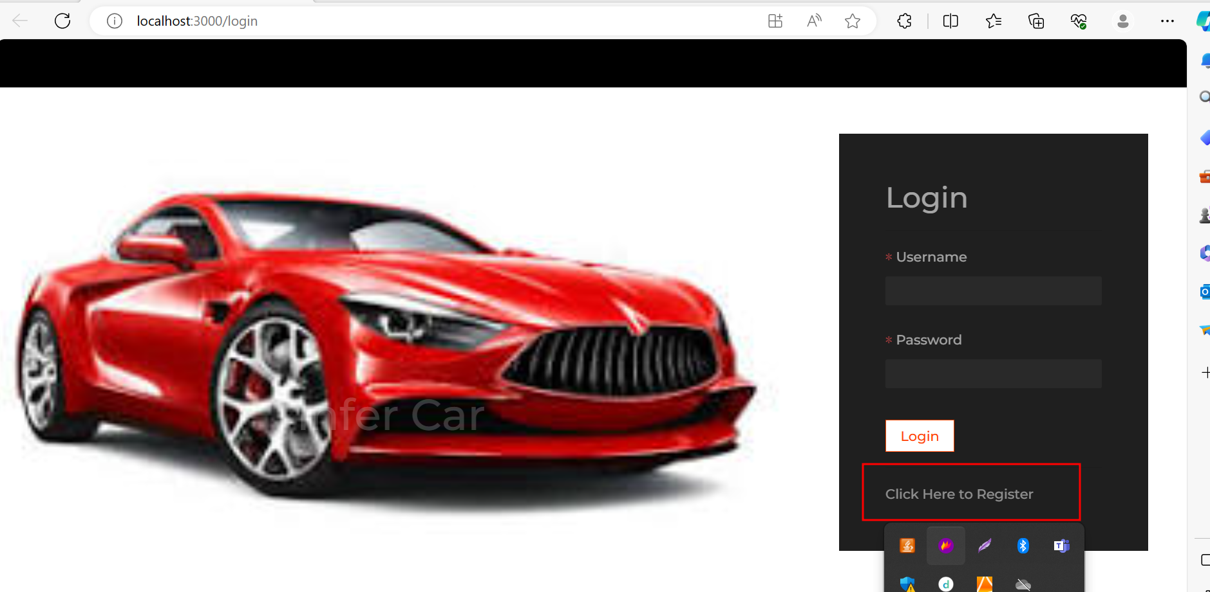
Now you do registration

Slide 19
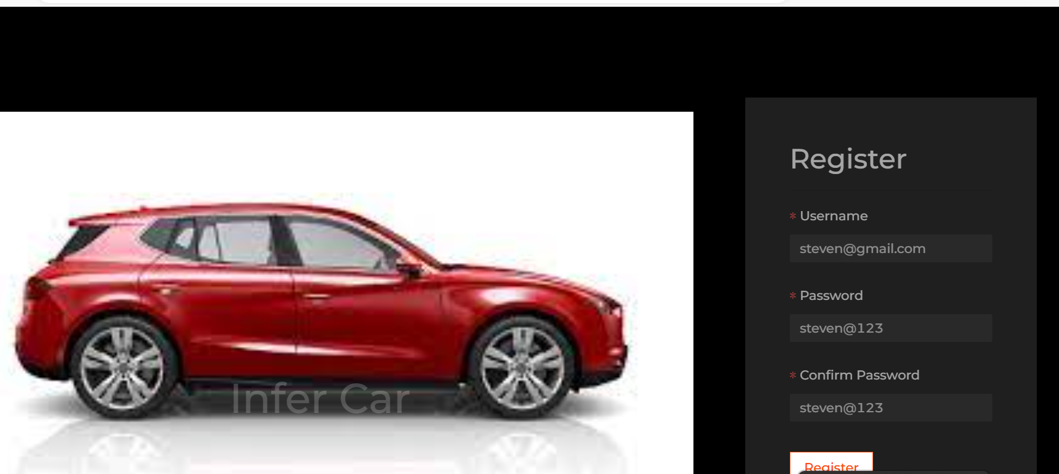

Slide 20
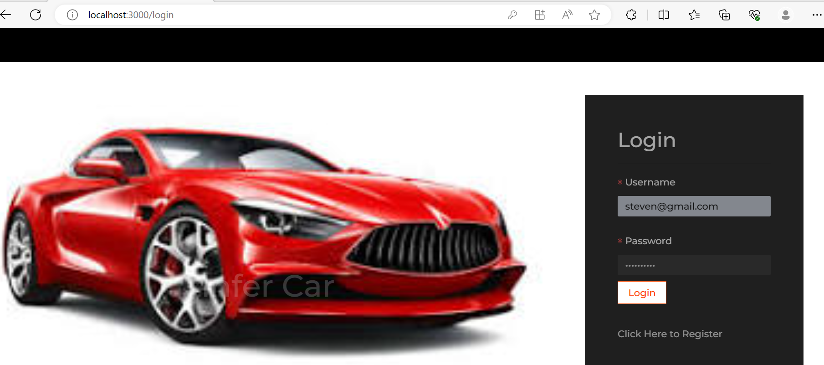
After registration you can do the login

Slide 21
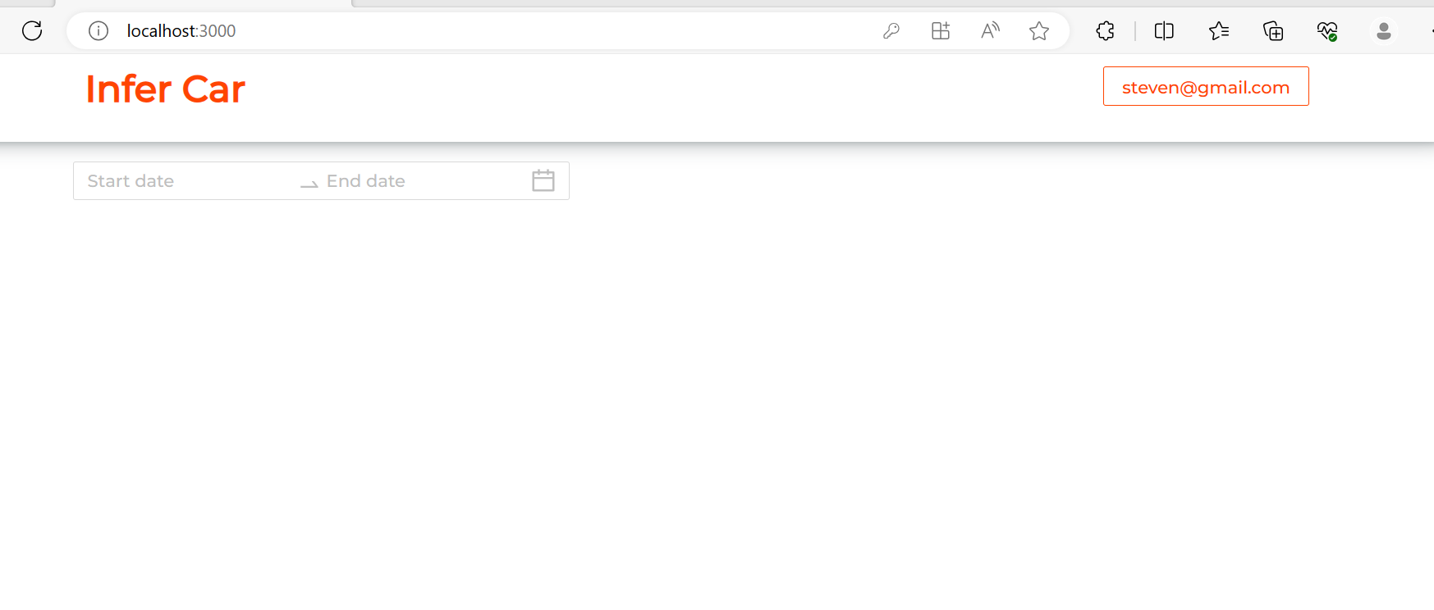
Dashboard

Slide 22
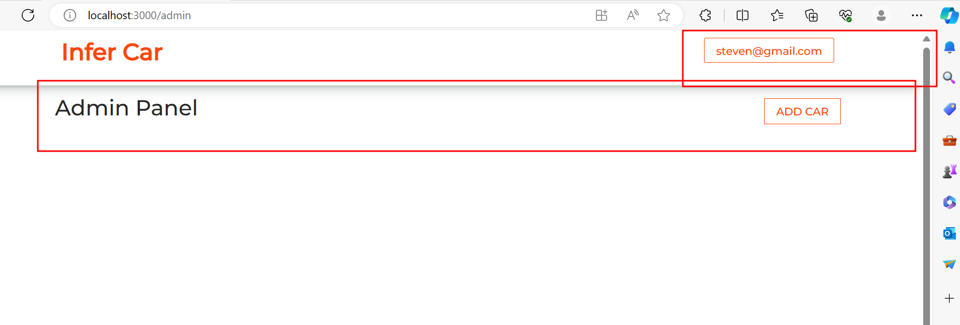
Using admin panel you can add the new cabs.

Slide 23
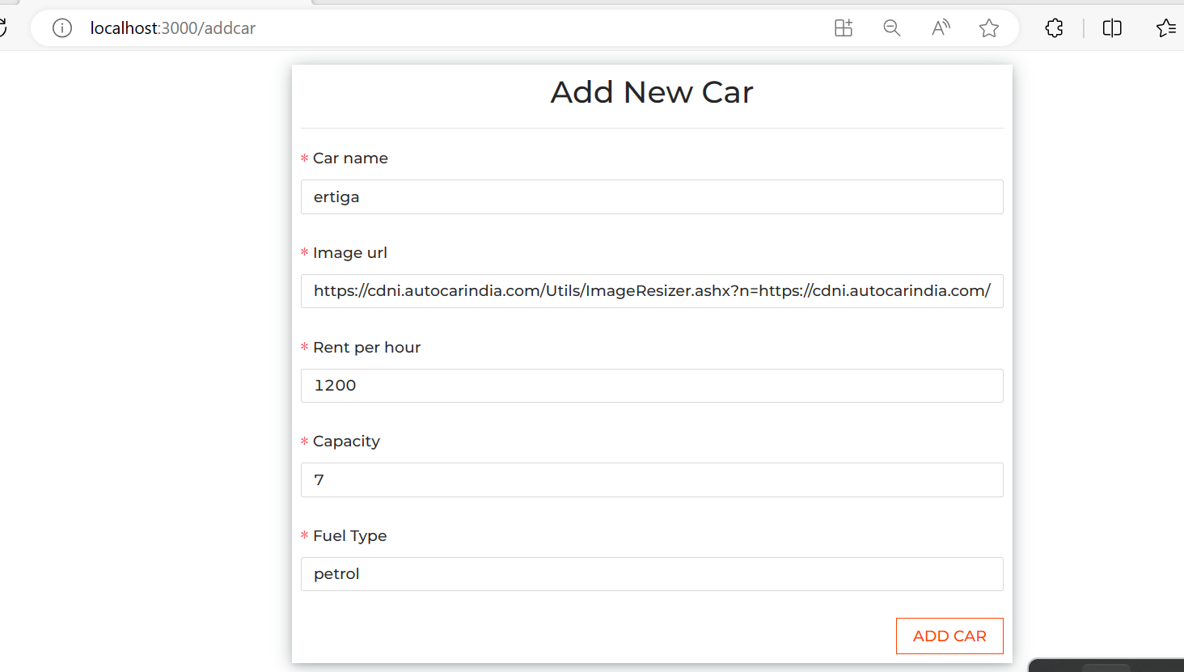
Add the car

Slide 24
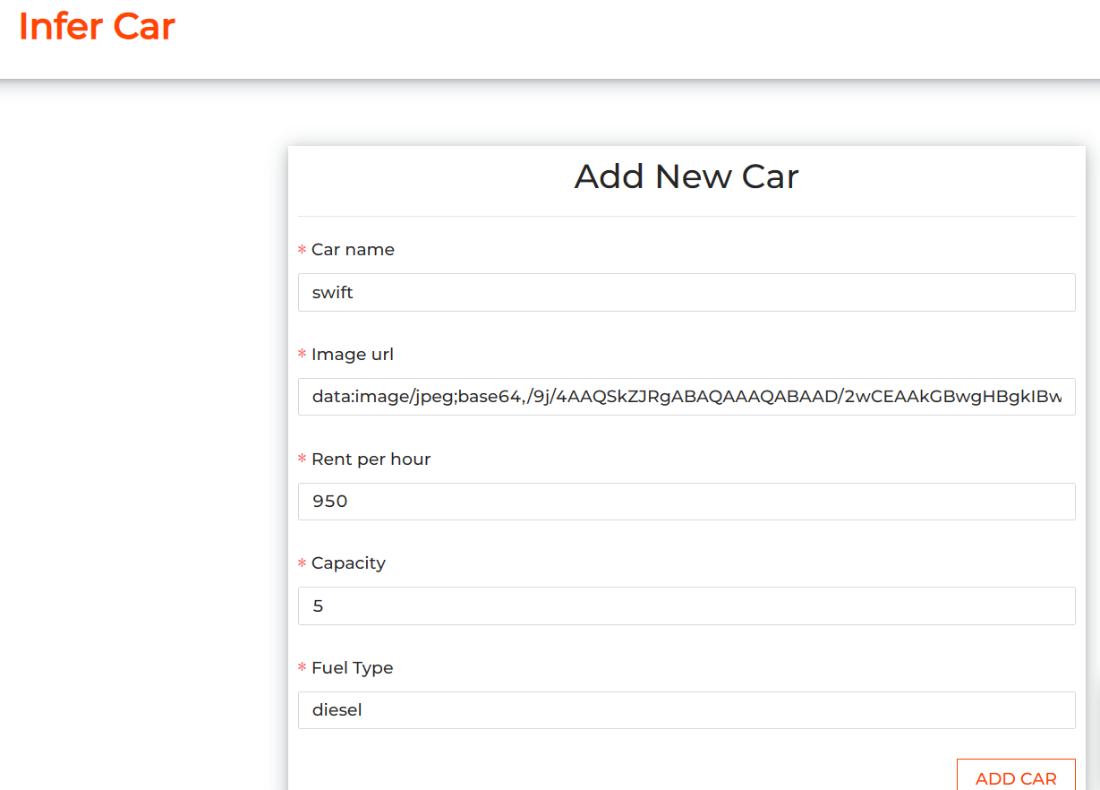
Add the car

Slide 25
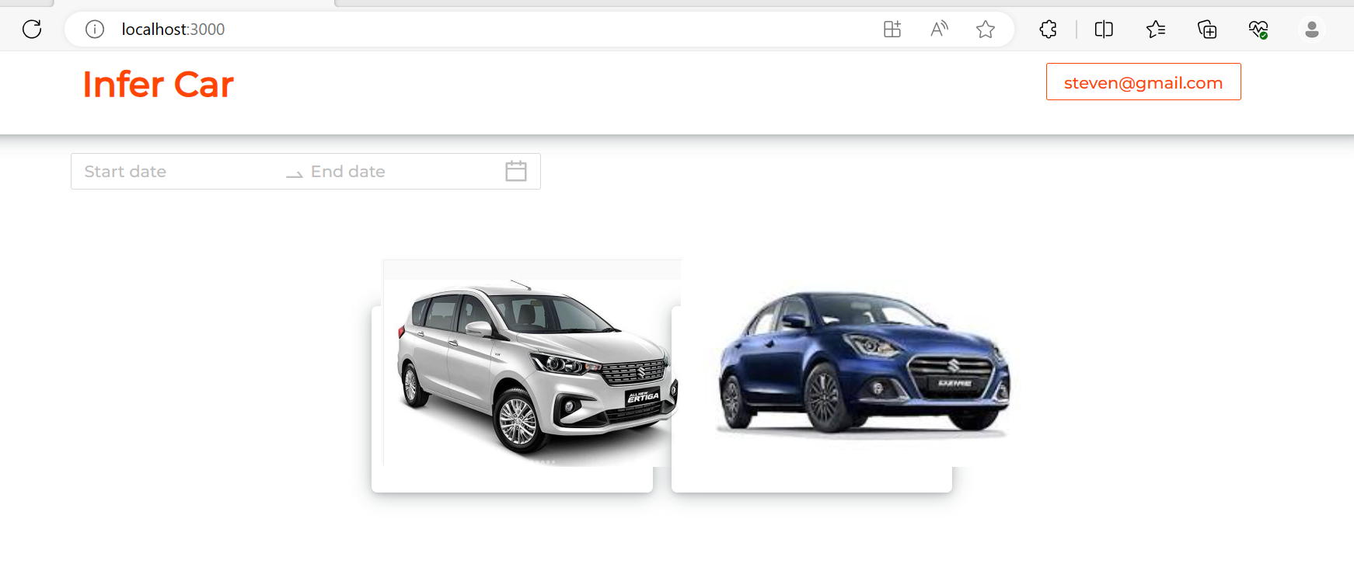
After added cars

Slide 26
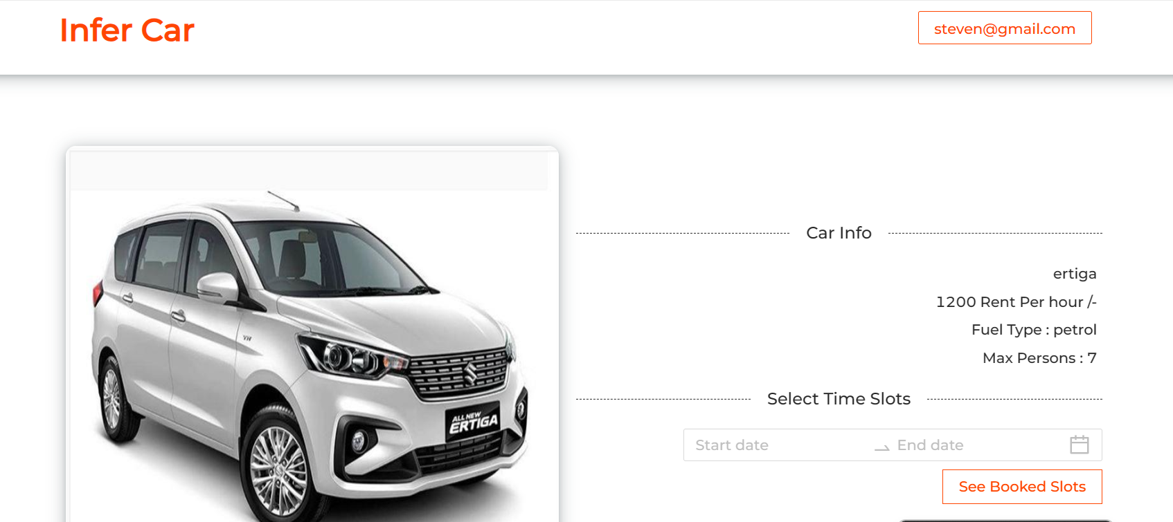
Now you can book the cab

Slide 27
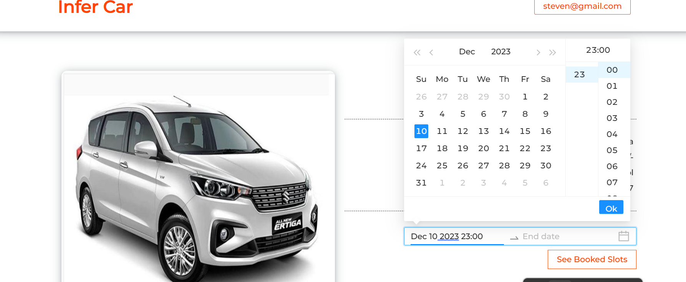
Please provide start date

Slide 28
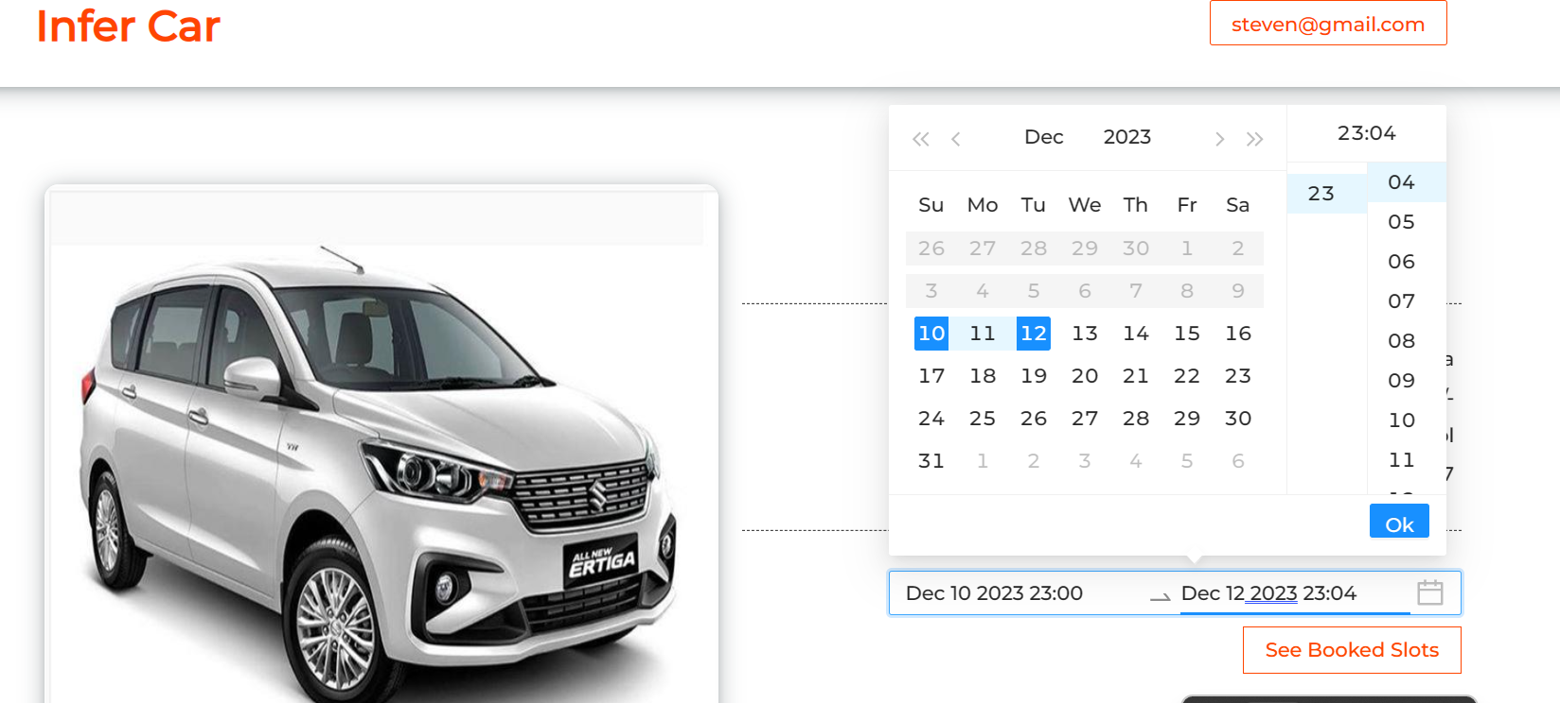
Please provide end date

Slide 29
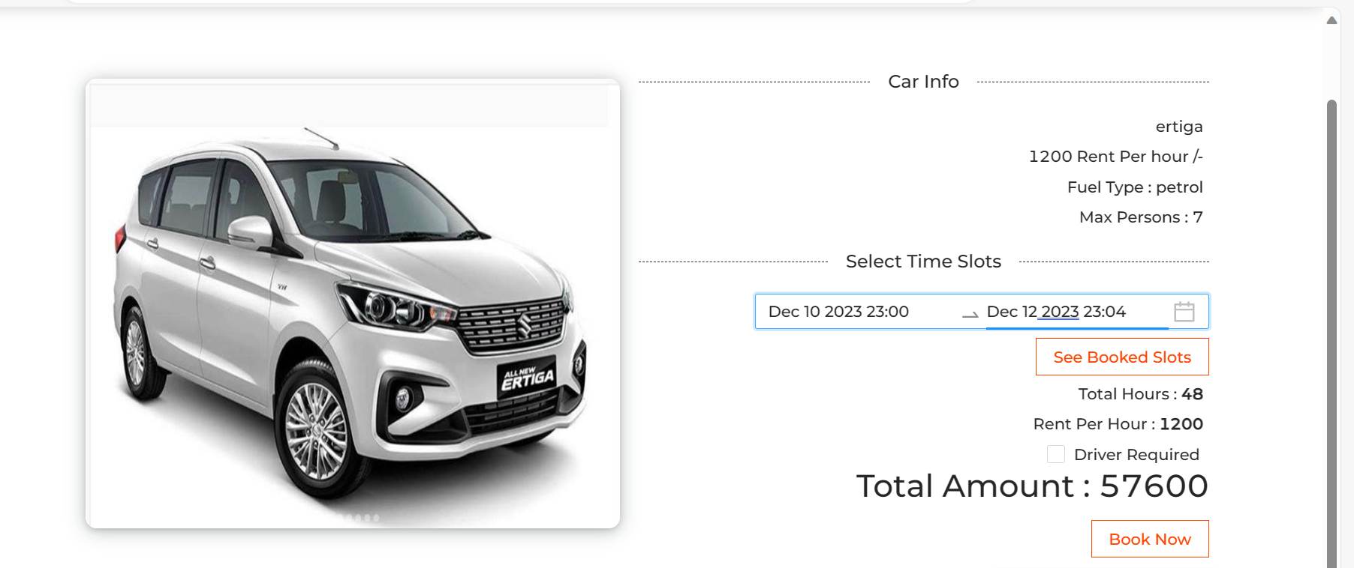
After selected date you can see details

Slide 30
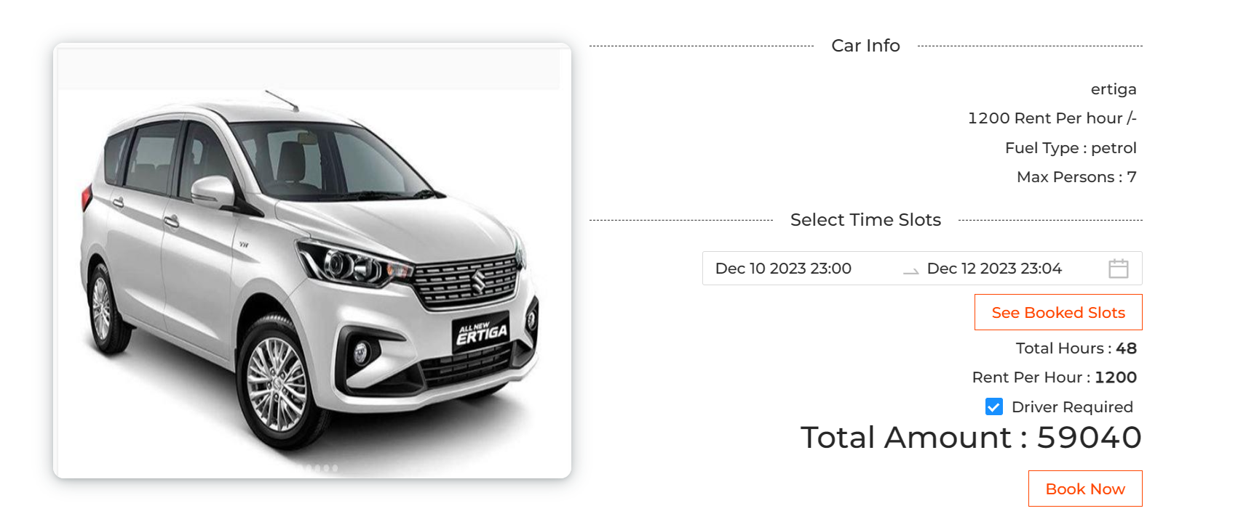
You can select the driver

Slide 31
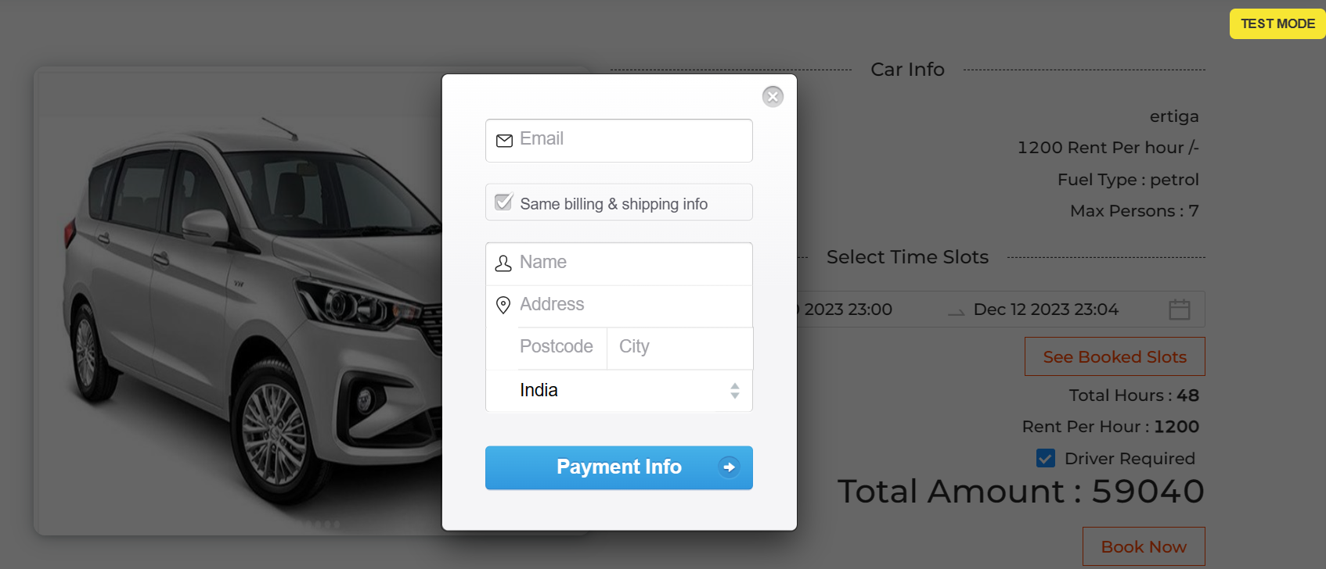
Once you click on book now it will open payment details page

Slide 32
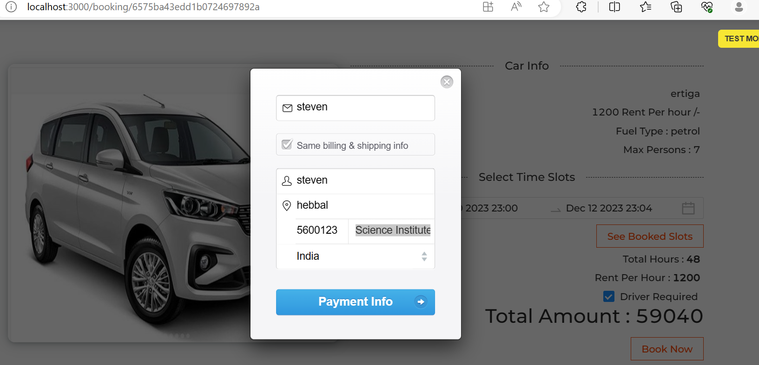
It will check information from live url

Slide 33
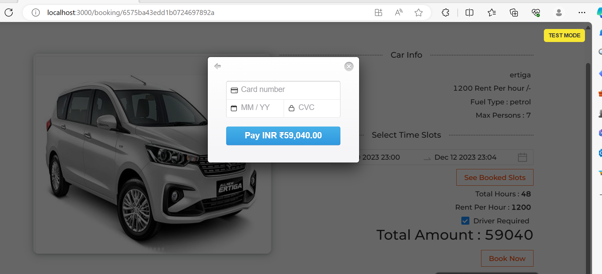
This payment is test mode

Slide 34
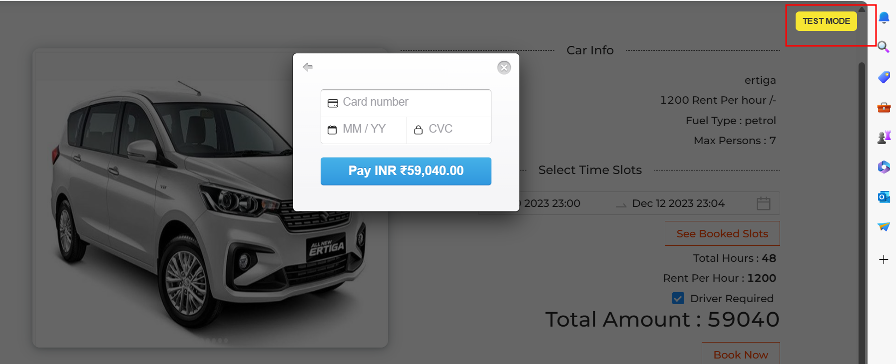
Please click on test model button

Slide 35
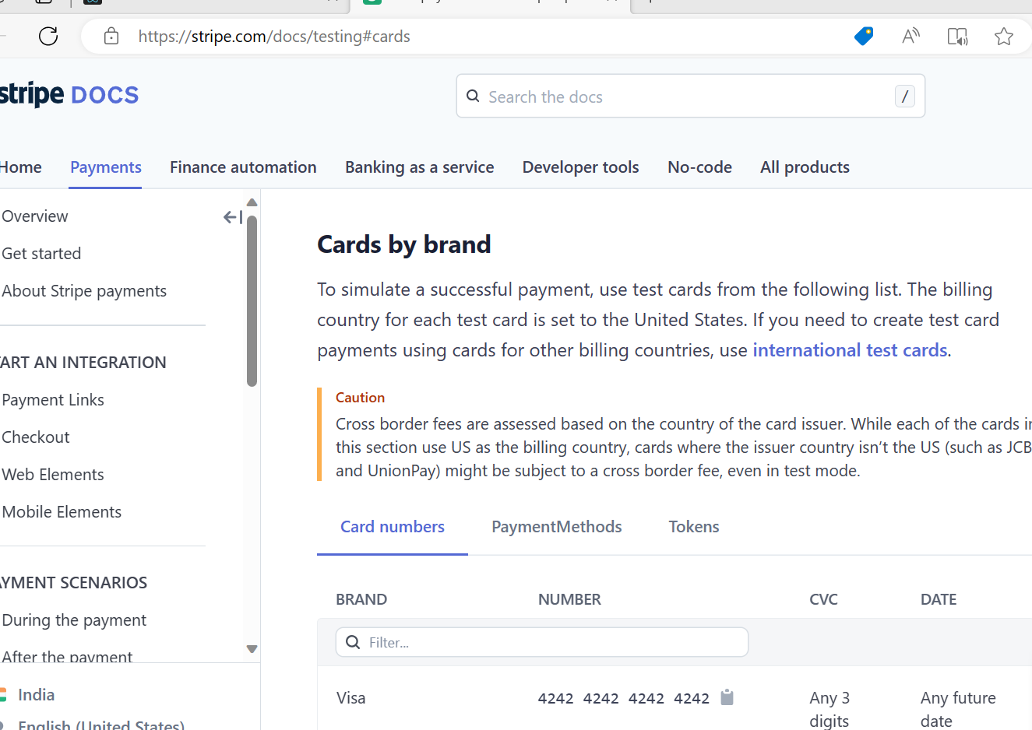
This is use stripe website

Slide 36
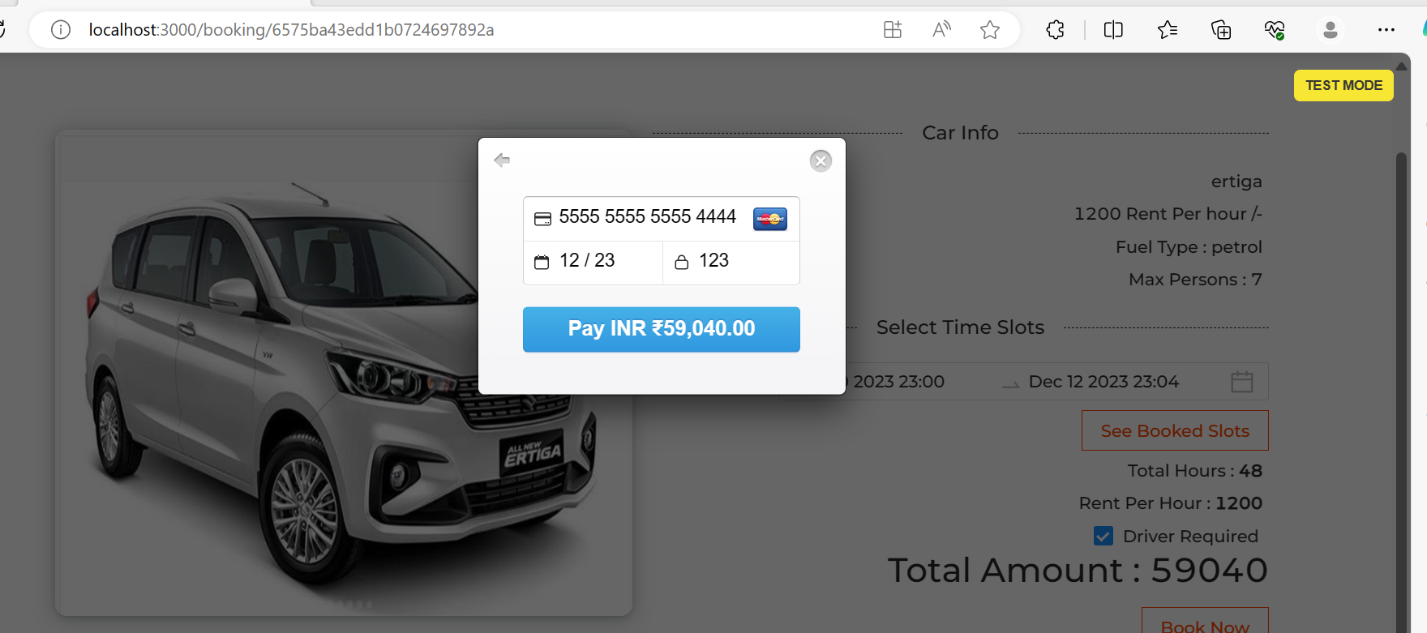
From this document you can get duppy card details to do the payment like a real time payment

Slide 37
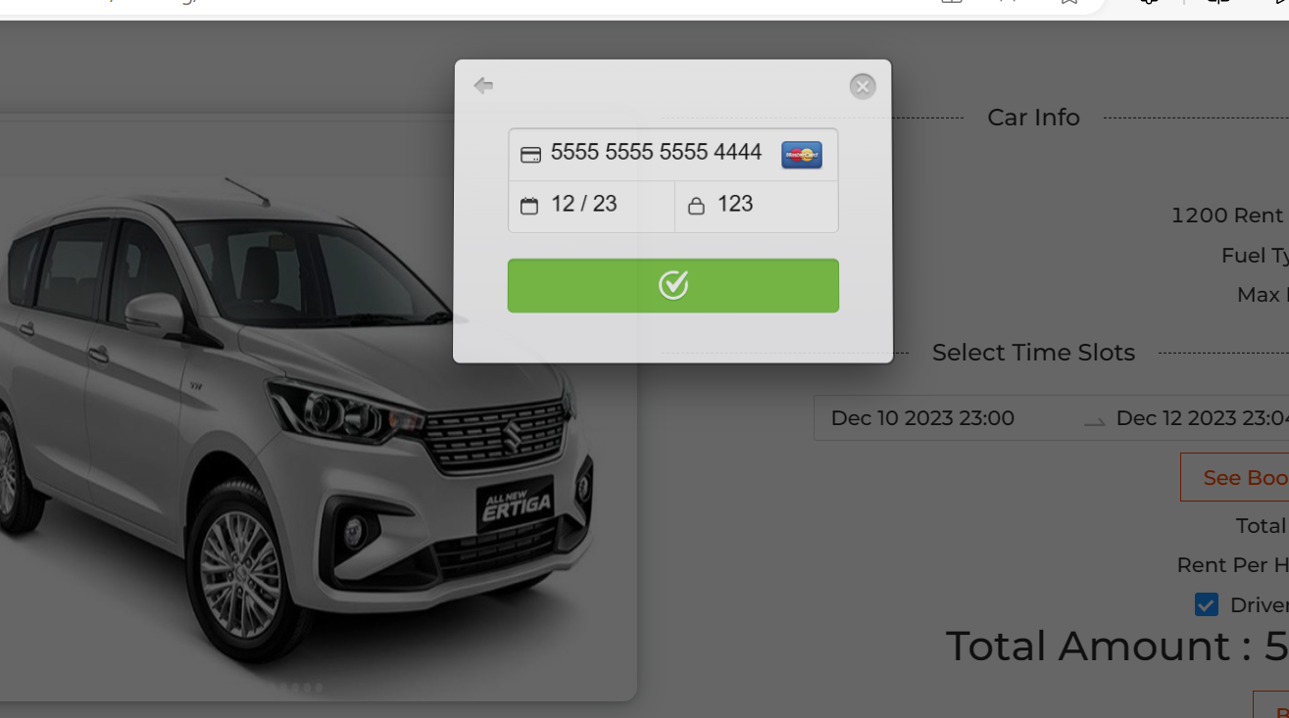
After click on payment

Slide 38
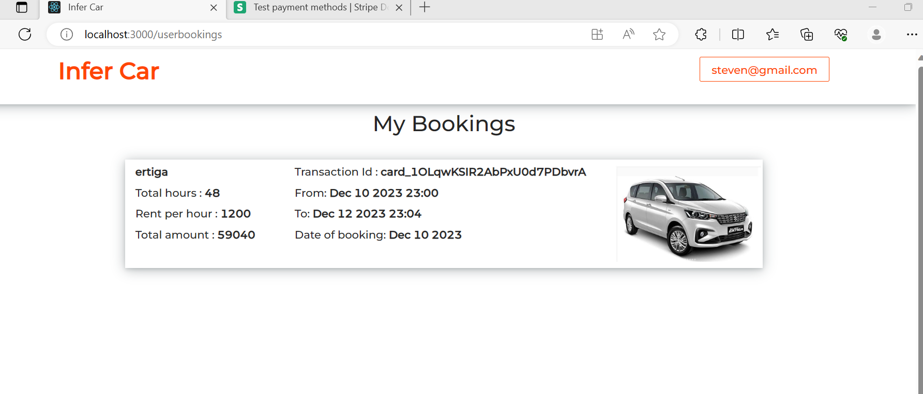
You can see the booking details

